Slide 1
MACHINE LEARNING ENHANCED ANALYSIS OF GRAVITATIONAL WAVE SIGNALS
KRISH NANAVATI
PART III ASTROPHYSICS RESEARCH PROJECT

Slide 2
OVERVIEW OF PROJECT
Outline of the presentation
Astronomical background:
What are GWs and what causes them? Understanding the waveforms that we are studying and the parameters that inform them
Machine learning:
Why are traditional methods for parameter inference limited? Machine learning tasks used specifically in PEREGRINE and in my project.
Results:
Investigations into optimising the posteriors produced by trying different methodologies, comparison to the TMNRE algorithm after round 1 of training

Slide 3
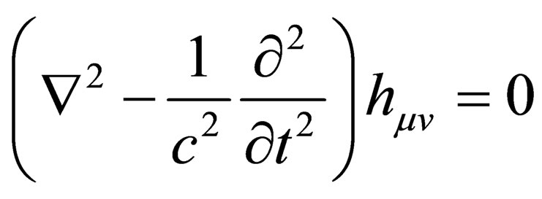
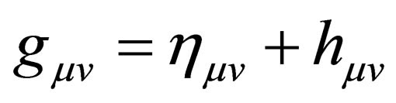
GRAVITATIONAL WAVES
Motivation for existence:
They arise in weak gravity limit, found by Einstein in 1916 as outcome of GR
Theoretical Properties
Wave-like behaviour exhibited by the metric of spacetime. Incredibly small effect relative to background spacetime, propagate at the speed of light
Detection of GWs
Indirect detection in 1974. LIGO was first direct detection – GW150914, prototypical GW event to study
Astronomical Events
Binary black hole mergers, Black hole – neutron star mergers, binary neutron star mergers, Continuous GWs and Stochastic GW background

Slide 4
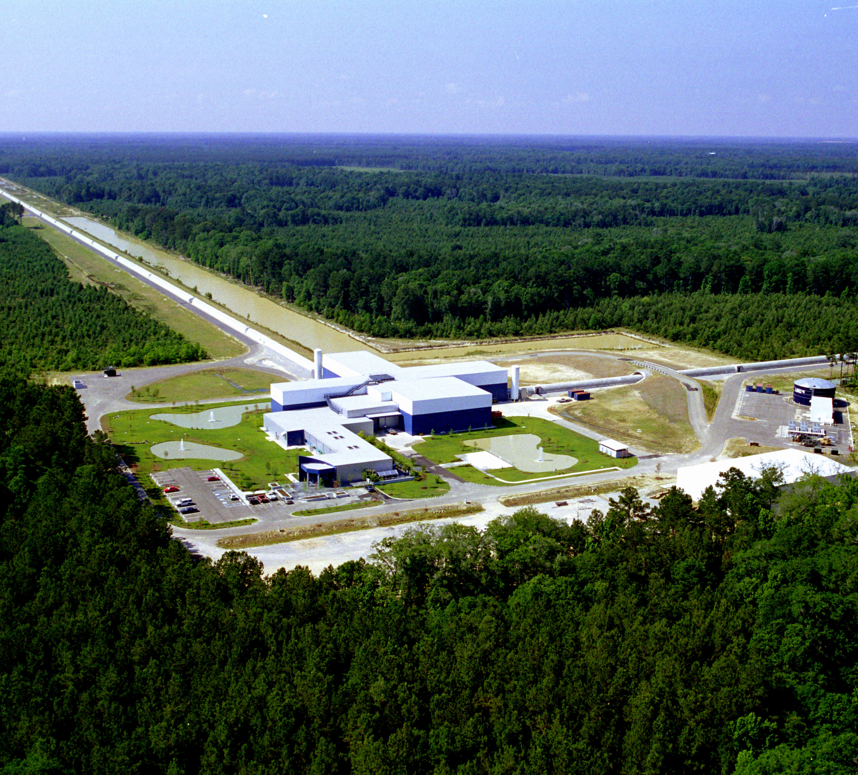
BINARY BLACK HOLE MERGERS
BBH Mergers
Type of detection made in GW150914, simplest binary system that can be studied
One of the strongest known sources of GWs in the universe
Mergers take place over the course of millions of years and release gravitational energy of the order of solar masses
Parameters that define the merger
15 used in the waveform generator we are interested in
Important ones include chirp mass, merger time, luminosity distance

Slide 5
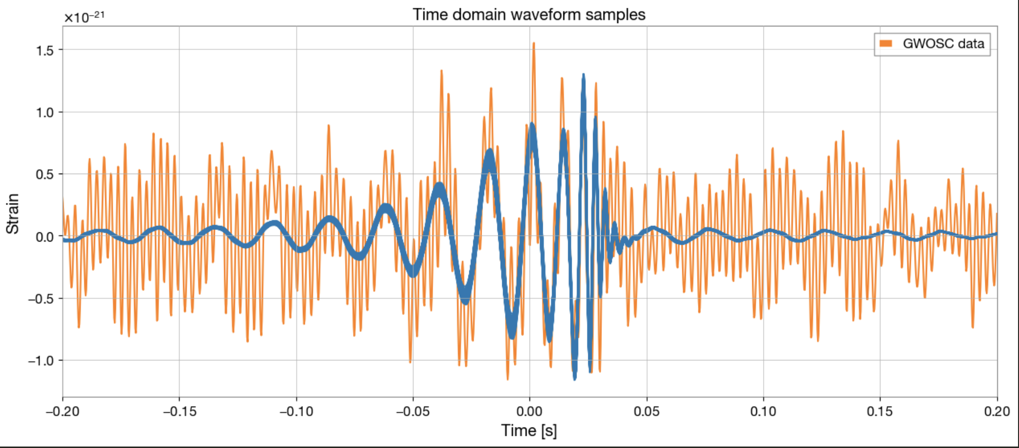
DETECTION AND DATA ANALYSIS
3 Stages of the Waveform
Inspiral, Merger and Rundown
Waveform generator IMRPhenomXPHM
Time domain and frequency domain simulator
Bayesian Inference and Posterior Estimation
Making inference from an observation – Bayesian regime
Signal to Noise Ratio, Matched Filtering

Slide 6
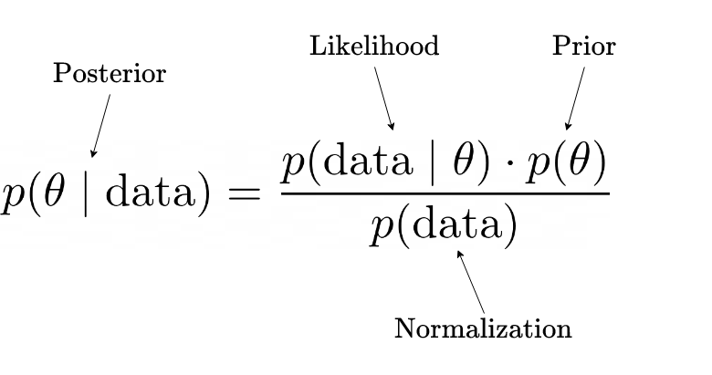
BAYES THEOREM AND SBI
Intractable in complicated cases! This is where simulators are used to take prior samples and generate data
This is what we are trying to estimate
Priors are usually simple functions determined by astrophysical data

Slide 7
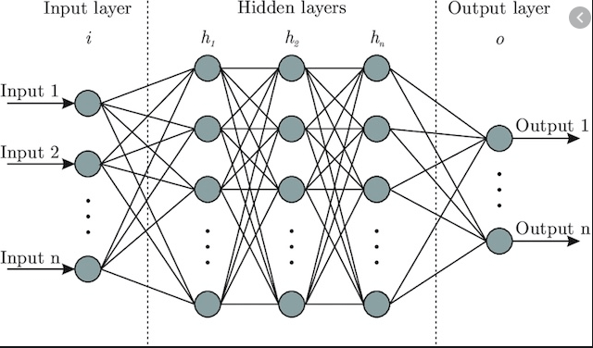
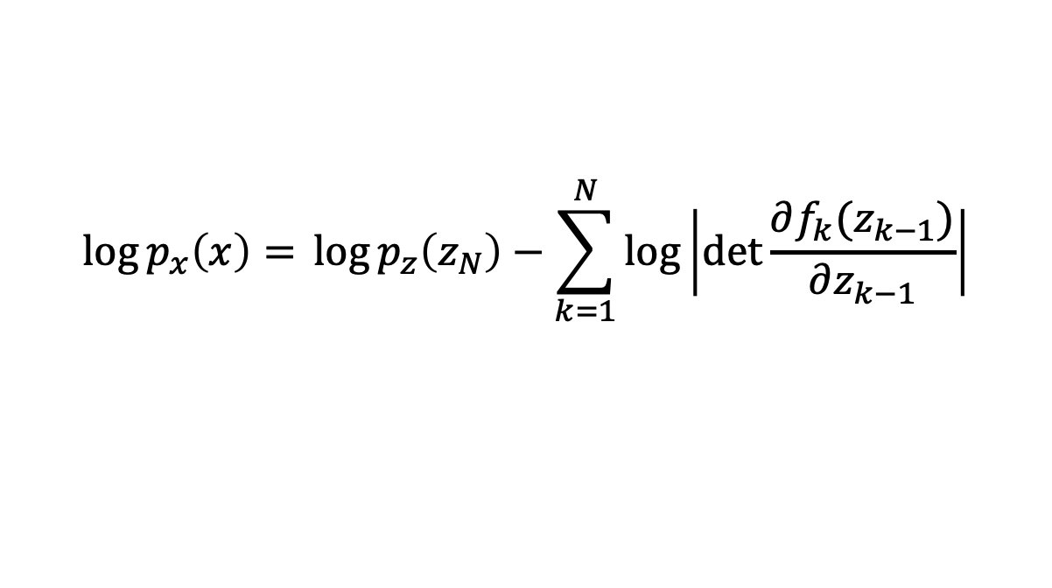
USE OF MACHINE LEARNING
Importance to Astrophysics
Complex and unstructured data sets, lots of noise, improvements in efficiency
Neural Networks
The importance of adding non-linear dependence to the system, simplest examples – feedforward NN
Normalizing Flow Architectures
Turn simple distributions into more complex ones by series of transformations
Directly access posterior probability distribution
$$\log{p_{x}\left(x\right)= }\log{p_{z}\left(z_{N}\right)}−\sum_{k=1}^{N}{\log\left|\det{\frac{∂f_{k}(z_{k−1})}{∂z_{k−1}}}\right|}$$

Slide 8
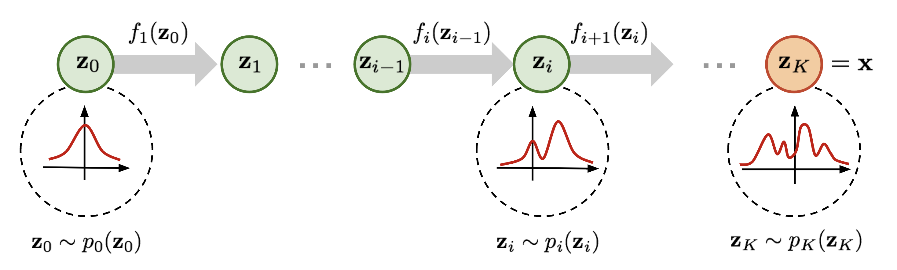
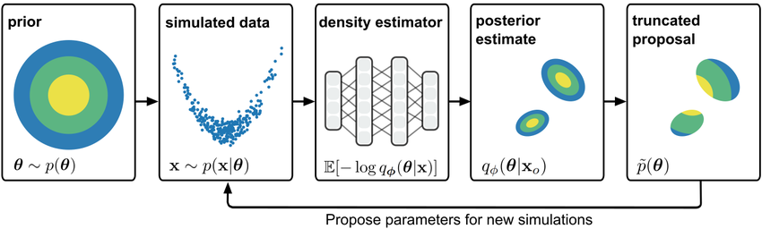
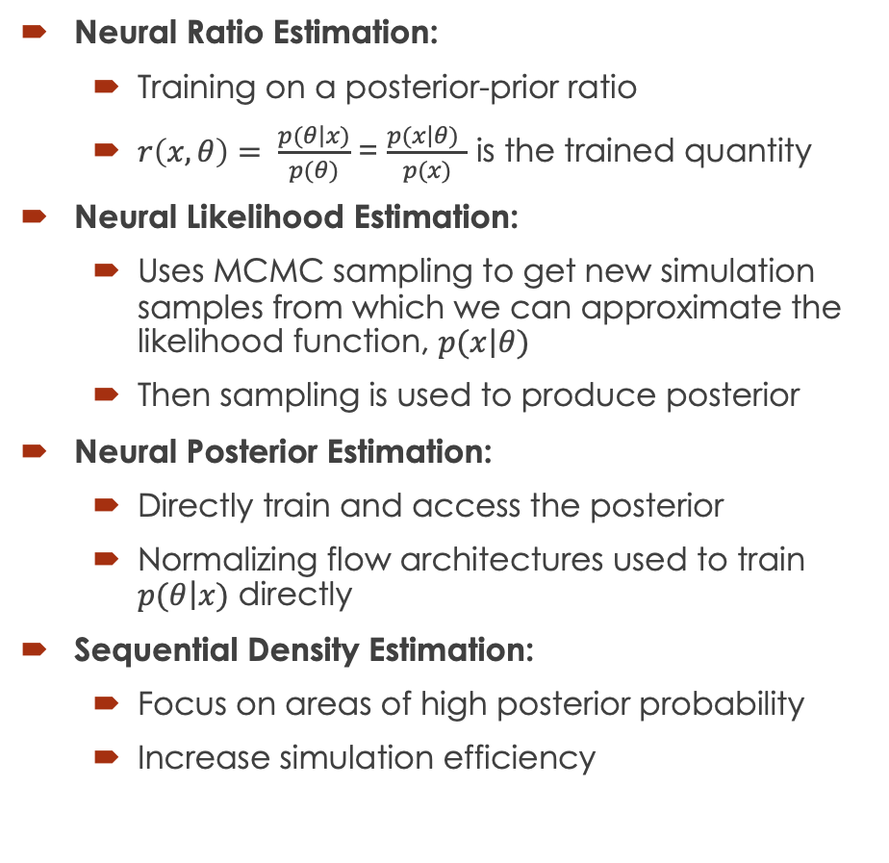
NN ENHANCED POSTERIOR ESTIMATION
Neural Ratio Estimation:
Training on a posterior-prior ratio
$r\left(x,θ\right)= \frac{p(\left.θ\right|x)}{p(θ)}$ = $\frac{p(\left.x\right|θ) }{p(x)}$ is the trained quantity
Neural Likelihood Estimation:
Uses MCMC sampling to get new simulation samples from which we can approximate the likelihood function, $p(\left.x\right|θ)$
Then sampling is used to produce posterior
Neural Posterior Estimation:
Directly train and access the posterior
Normalizing flow architectures used to train $p(\left.θ\right|x)$ directly
Sequential Density Estimation:
Focus on areas of high posterior probability
Increase simulation efficiency

Slide 9
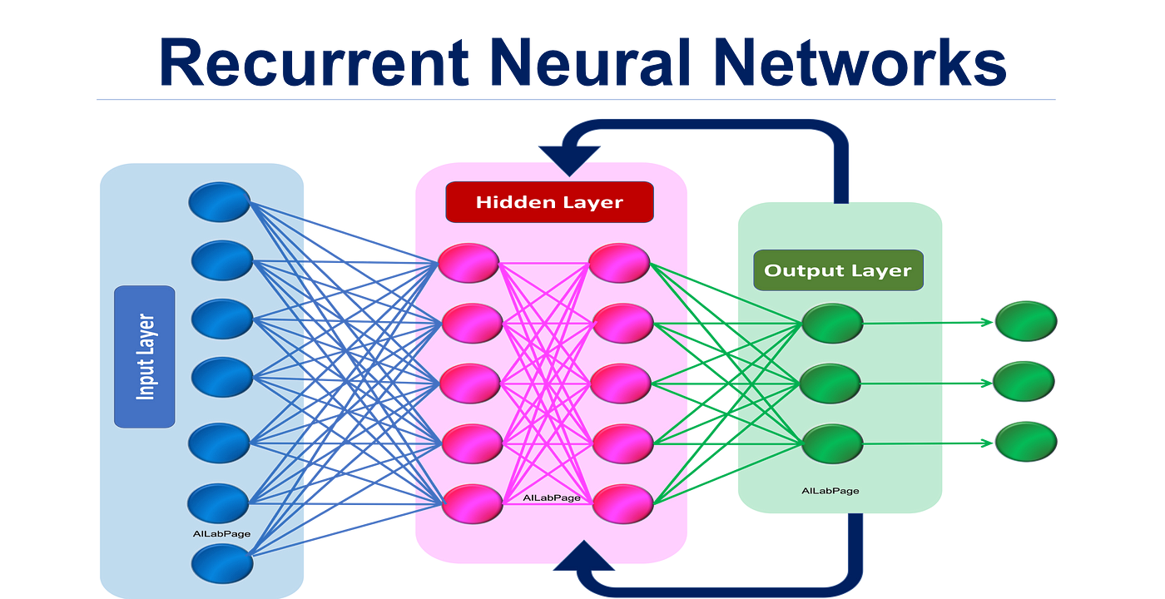

EMBEDDING NETS
Data Challenge of Posterior Estimation:
Complex, unstructured data parsed directly into the network is very inefficient
GW data is in a 15-dimensional parameter space, both time and frequency domain data
Transformed to a latent space where training is carried out
Position of embedding nets in pipeline:
Training data is given to network
Data is parsed through an embedding net
Lower dimensional latent space representation returned
Training done on this representation
Types of structures in embedding nets:
Simple neural networks, CNNs and RNNs

Slide 10
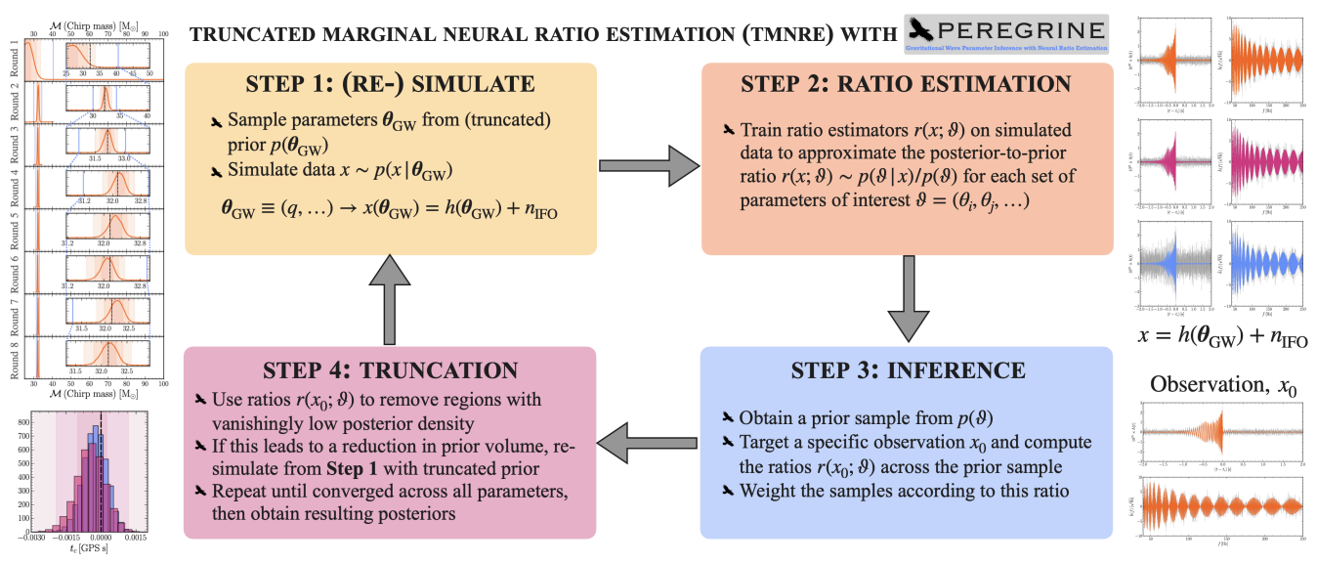
PEREGRINE AND OUR GOAL
What is PEREGRINE?
SBI pipeline for GW parameter inference using TMNRE
Very simulation efficient compared to traditional methods
Outline of the architecture
Inference run on the ratio
Truncation step before re-simulation
Intended outcomes
Replace the TMNRE algorithm with SNPE
Compare the results

Slide 11
RESULTS: POSTERIOR PLOTS
The graph here shows the provisional result of SNPE against Dynesty
Widely used nested sampling algorithm for gravitational wave inference
Dynesty shows the final trained posteriors
Along the main diagonal we have 1D marginal posteriors, whilst the off-diagonals are the joint 2D marginal posteriors
Similar results showing agreement
More training needed for the SNPE case but strong start
Different parameters trained different amounts

Slide 12
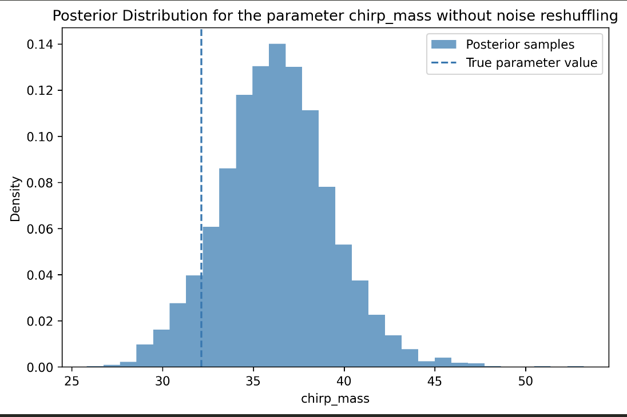
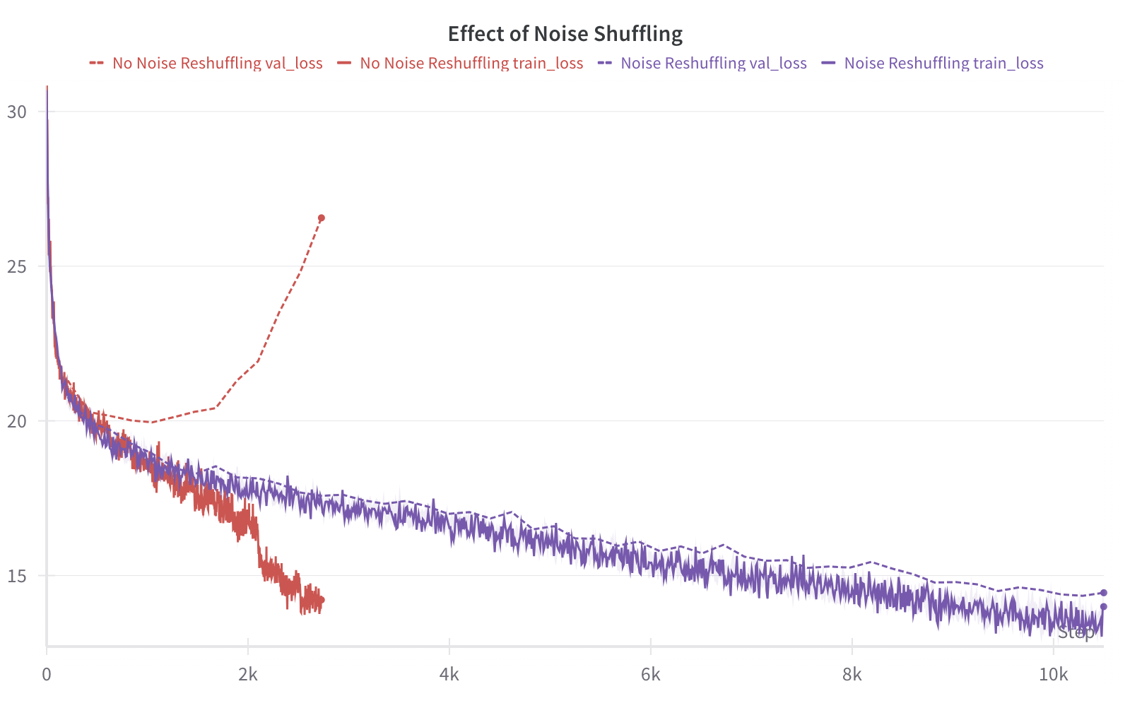
RESULTS: NOISE RESAMPLING
The importance of noise shuffling is clear here, looking at the validation loss curves and the ‘trained’ posterior with and without
Noise shuffling is applying a permutation of the noise values to the data

Slide 13
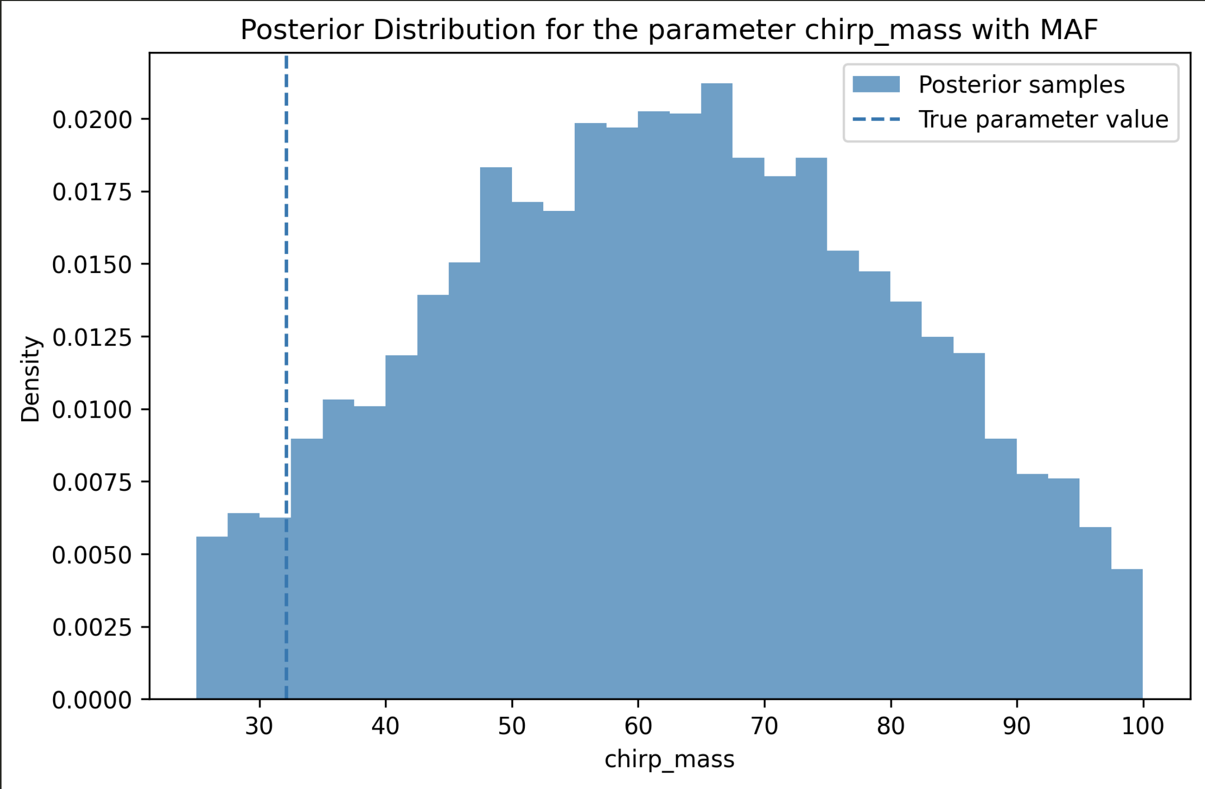
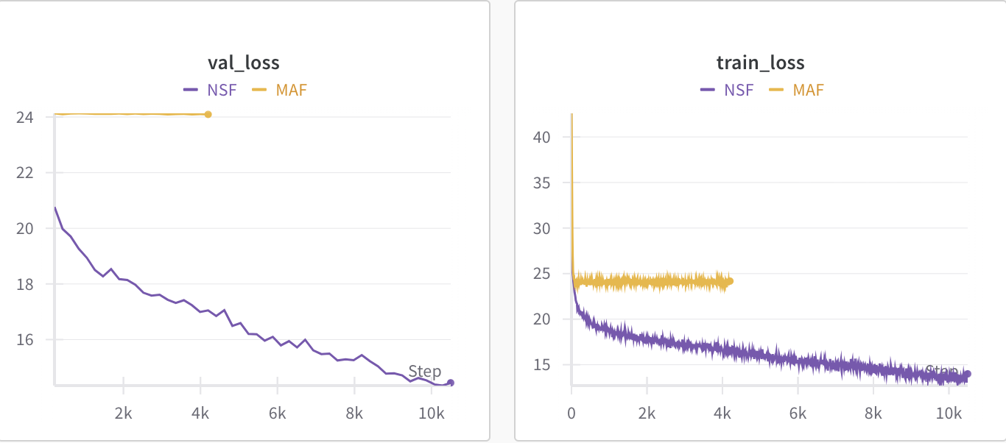
RESULTS: MAF vs NSF
Neural Spine Flows and Masked Autoregressive Flows are two normalizing flow architectures that are built into the SBI library
The MAF is less stable during training and often doesn’t converge, as shown by the loss curves
The NSF is much more reliable and produces similar results repeatedly

Slide 14
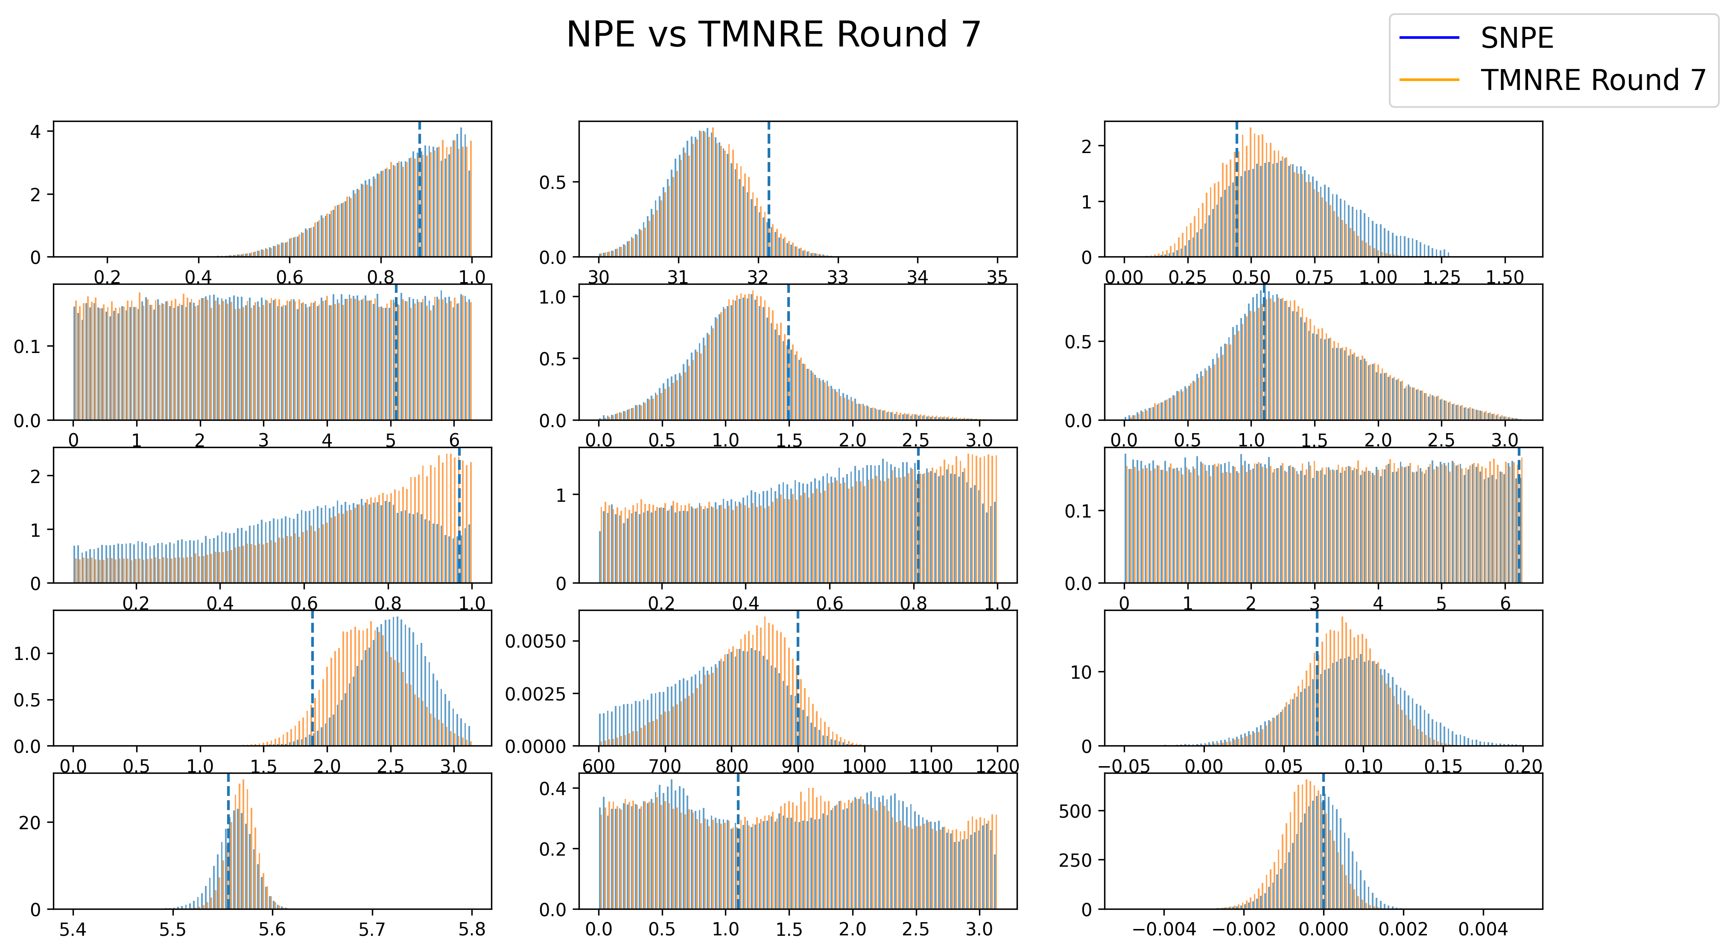
RESULTS: NPE vs TMNRE
The graphs show the (zoomed in) posterior samples from the NPE algorithm and the 7th round of TMRE

Slide 15
FUTURE RESULTS
Comparing NPE to SNPE when fully implemented
Interested in seeing the relative simulation efficiency between the two
Multiple rounds
When truncation procedure fully implemented
Looking at joint marginal posteriors
Create and compare the corner plot after all rounds comparing the joint 2D marginal posteriors
Use real GW events and produce posteriors from that
GW150914 as an example case
Statistical comparisons to TMNRE posteriors to get concrete conclusions
Jensen-Shannon divergence as one example

Slide 16
CONCLUSION
Why are we interested in SNPE for GW parameter estimation?
Efficient posterior estimation, more flexibility to get joint distributions in early rounds of training, alternative methods that may be more applicable to certain types of problems
How does SNPE compare to TMNRE from our results so far?
Learns different parameters in earlier rounds of training
Constrains chirp mass, merger time and similar parameters a similar amount in first round of training
Further applications of GW posterior estimation
LISA data

